Slide 1
Big Data Processing
Jiaul Paik
Lecture 5

Slide 2
Difficulties with Traditional Cluster Computing
Node failures => data loss
Data communications between nodes through network
Programming difficulties
Concurrency control
Debugging
Load balancing

Slide 3
ADDRESSING DIFFICULTIES MAP-REDUCE FRAMEWORK

Slide 4
Stands on the Key Ideas
The datacenter is the computer
Computers holding data will compute (NOT the central server)
Bring computation to the data
Reduce data communication
Programming: Divide and Conquer approach
Break into independent sub-problems
Solve them parallelly
Combine the results
Simple programming model
Map-reduce framework does all other things for the programmer

Slide 5
Programming Model Overview (Map-reduce)

Slide 6
Simple Programming Model: Map-reduce
Simple programing model
Mainly using two functions (map-reduce)
Map
Reduce
Programmer’s responsibility:
define only two functions, Map and Reduce suitable for your problem

Slide 7
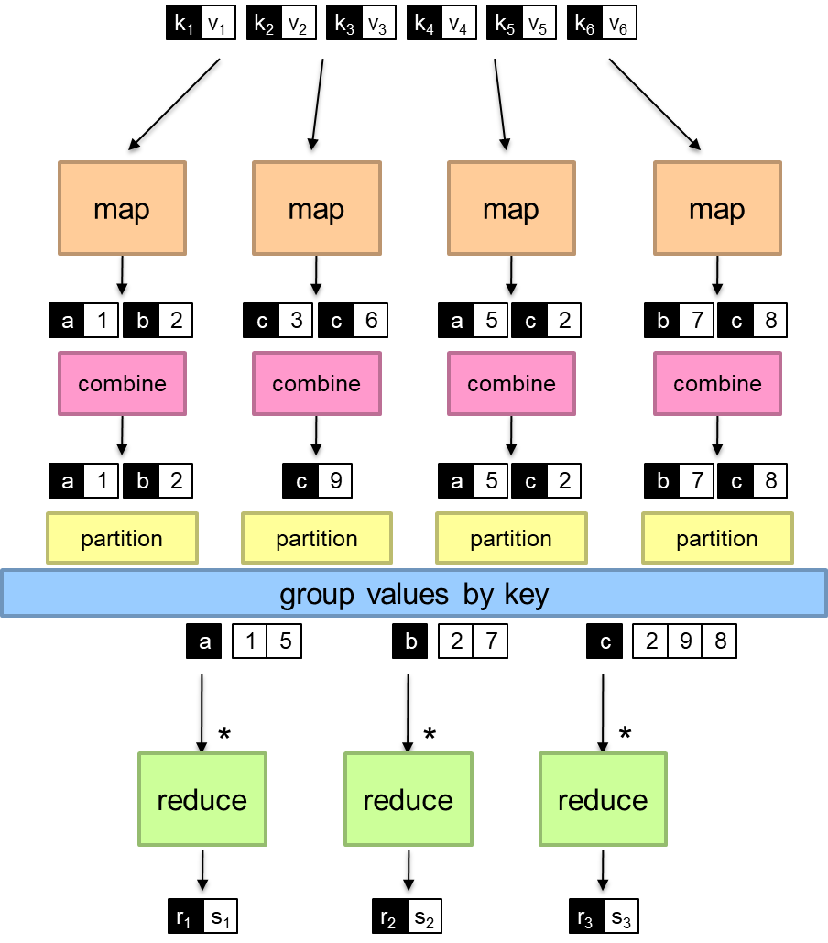
Map-reduce Programming Model
Splitting
Parallel programming
Intermediate combining
Shuffling and grouping
Final combining

Slide 8
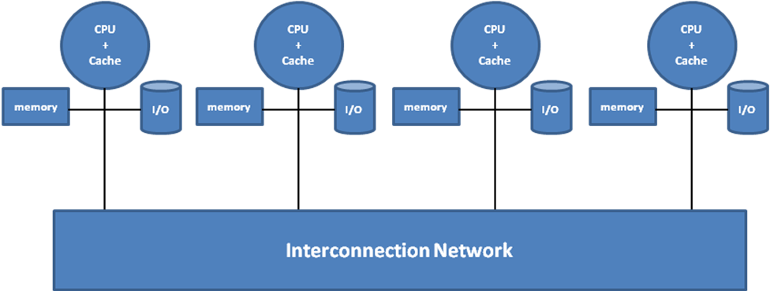
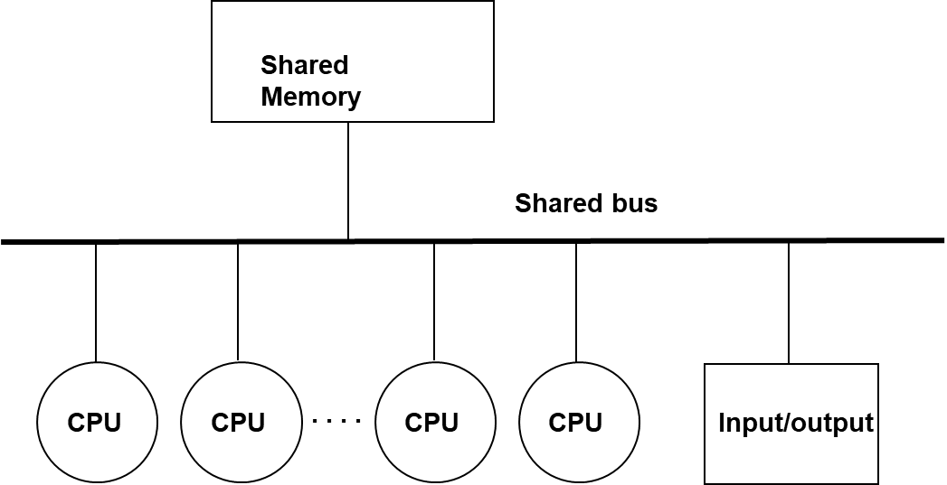

Parallel Programming
Cluster
Multi-processor
Distributed programming
Multi-threaded programming

Slide 9
Multithreaded Programming

Slide 10
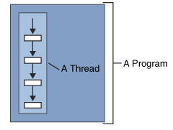
What is a thread?
A thread is a single sequential flow of control within a program
A thread can’t run on its own
It must run within a program

Slide 11
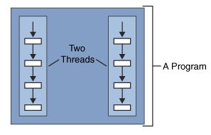
What is multithreading?
Multiple threads running at the same time and performing different tasks in a single program

Slide 12
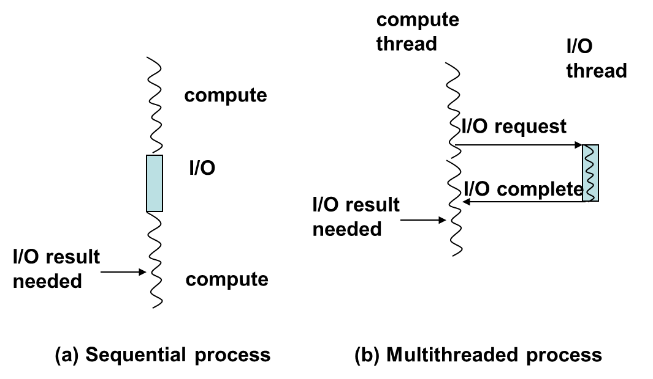
Why Multithreading?
Better, more abstract, more modular way of solving a problem
Separate computation from I/O
Take advantage of multiprocessors

Slide 13
Multiprocessors
Shared Memory
Shared bus
CPU
CPU
. . . .
CPU
CPU
Input/output
Threads of same process have identical views of memory hierarchy despite being on different physical processors.

Slide 14
Programming support for threads
Threads as a programming abstraction.
Major operations
dynamically create threads
communicate among threads
synchronize activities of threads
terminate threads

Slide 15
Thread creation and termination
A thread executes some portion of a program
Just like a program, it has an entry point where it begins execution
The entry point is defined as the address of some function

Slide 16
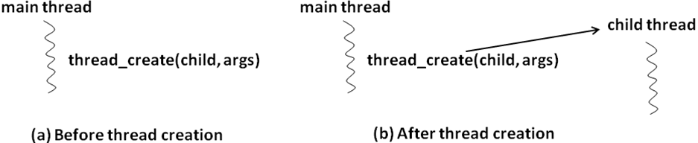
Thread creation and termination
tid_t thread_create (top-level procedure, args);

Slide 17
Processes are Protected
Process
Process
Process
Process
Process

Slide 18
Multiple Threads Can Exist in a Single Process Space
Process
Thread
Process
Thread
Thread
Thread
Thread
Thread
Thread
Thread
Process
Process
Thread
Thread
Thread
Process
Thread

Slide 19
Thread creation and termination
Thread automatically terminates when it exits the top-level function it was created from
We can explicitly terminate a thread
thread_terminate (tid);
tid is the system-supplied identifier of the thread we wish to terminate.

Slide 20
Communication among threads
Threads share the same address space
sharing memory is simple
Appropriately qualified static variables can be visible to multiple threads

Slide 21
Data race and Non-determinism
Data Race:
A condition in which multiple concurrent threads are simultaneously trying to access a shared variable
and at least one threads trying to modify the shared variable.
int flag = 0; /* shared variable
initialized to zero */
Thread 1 Thread 2
while (flag == 0) { .
/* do nothing */ .
} .
if (flag == 0) flag = 1;
.
.

Slide 22
Data race and Non-determinism
int count = 0; /* shared variable initialized to zero */
Thread 1 (T1) Thread 2 (T2) Thread 3 (T3) Thread 4 (T4)
. . .
. . .
count++; count++; count++; printf(count)
. . . .
. . . .

Slide 23
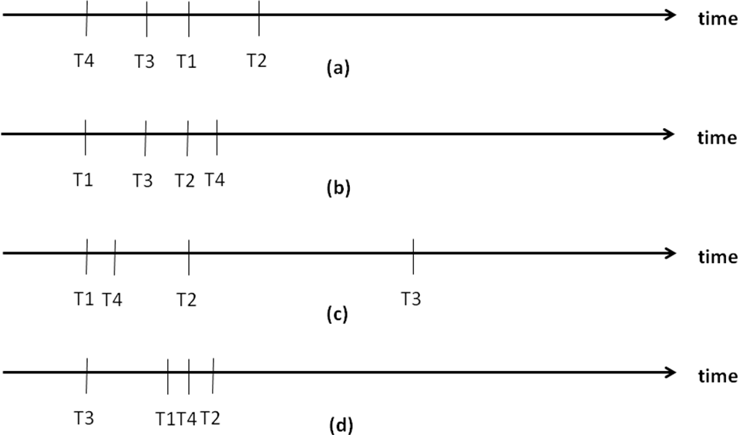
Data race and Non-determinism
Output depends on the order of execution
Non-deterministic!

Slide 24
Data race and Non-determinism
Sequential Programming
Program Order
Deterministic
Parallel Programming
Within a thread execution is program order
Order of execution of threads determined by a thread scheduler
Non-deterministic
Results may vary

Slide 25
Synchronization among threads
Critical Sections
Sections of code in different threads (or processes) which access the same shared variable(s)
Need to avoid any two critical sections from being active simultaneously
Mutual Exclusion
if one is in a critical section it must exclude the other and vice versa.
Variables used for this purpose are called mutex

Slide 26
Synchronization among threads by locking
while(MUTEX == LOCKED)
do nothing;
operations involving shared variables
MUTEX = LOCKED;
MUTEX = UNLOCKED;

Slide 27
Synchronization among threads
T1
T2
T3
T4
Critical section
Critical section
Critical section
Critical section

Slide 28
Synchronization among threads
T1
T2
T3
T4
Critical section
Critical section
Critical section
Critical section
T1 is active and executing code inside its critical section.
T2 is active and executing code outside its critical section.
T3 is active and executing code outside its critical section.
T4 is blocked and waiting to get into its critical section. (It will get in once the lock is released by T1).

Slide 29
Multithreading programming libraries
In C (POSIX): pthread library
In python: threading module

Slide 30
Python Examples

Slide 31
Finding sum of numbers
def partSum(data, result, id, start, end):
sum = 0
for i in range(start, end):
sum = sum+data[i]
result[id] = sum
from threading import Thread
threads = [None] * 5
results = [None] * 5
data = [2, 3, 5, 8, 10, 12, 14, 17, 20, 25, 12, 16, 17, 17, 19]
size = int(len(data)/len(threads))
for i in range(len(threads)):
start = i*size
end = (i+1)*size
threads[i] = Thread(target=partSum, args=(data, results, i, start, end))
threads[i].start()
for i in range(len(threads)):
threads[i].join()
# final sum
finalsum=0
for i in results:
finalsum = finalsum+i
print(finalsum)
Same function on different chunk of data

Slide 32
Finding variance of a set of numbers
def calSumOfSquare(data, res, i):
sum = 0
for n in data:
sum = sum + n*n
res[i] = sum
def calMean(data, res, i):
sum = 0
for n in data:
sum = sum + n
res[i] = sum/len(data)
import threading
data = [2, 3, 5, 8]
results = [None] * 2
sosThread = threading.Thread(target=calSumOfSquare, args=(data, results, 0))
meanThread = threading.Thread(target=calMean, args=(data,results, 1))
sosThread.start()
meanThread.start()
sosThread.join()
meanThread.join()
var = results[0]/len(data) - results[1]*results[1]
print(var)
Different functions in different threads

Slide 33
An Example Problem Top k Similarity Search

Slide 34
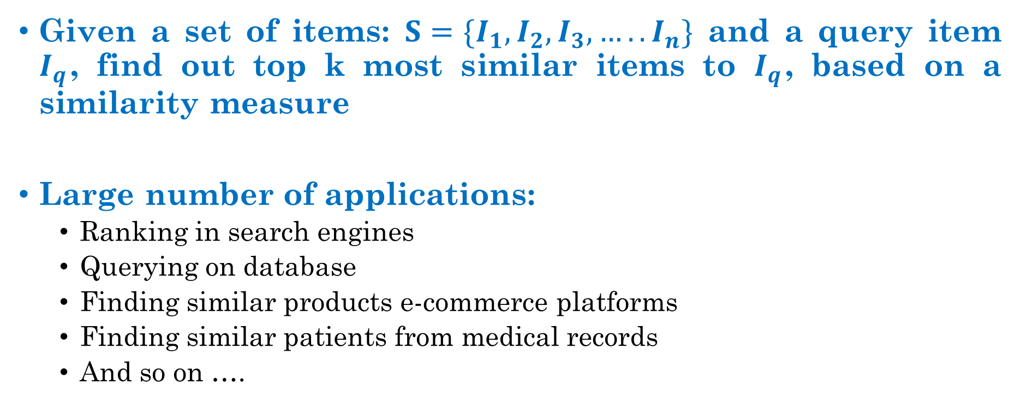
Top k Similarity Search
Given a set of items: $S=\{I_{1}, I_{2}, I_{3}, ….. I_{n}\}$ and a query item $I_{q}$, find out top k most similar items to $I_{q}$, based on a similarity measure
Large number of applications:
Ranking in search engines
Querying on database
Finding similar products e-commerce platforms
Finding similar patients from medical records
And so on ….
How do we solve it?

